Slide 1
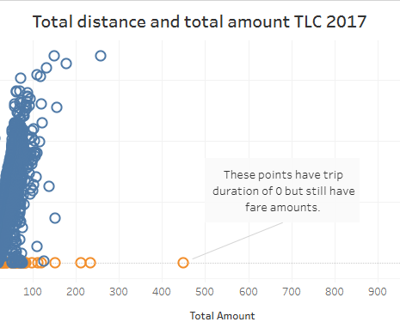
Exploratory Data Analysis for NYC TLC Data
Executive Summary Report
Commission Prepared by Automatidata
Project Overview
The NYC Taxi and Limousine Commission (TLC) has collected detailed taxi and rideshare trip data. Our objective is to create a regression model to predict taxi fares.
Problem:
After conducting initial EDA it is observed that some data points will be hurdle for predicting accurate ride fair prediction.
Image Alt-Text Here
Proposed solution:
We recommend removing outliers with total distance of 0
Scatter Plot Between ‘total_distance’ and ‘total_amount’.
Clean data and remove outliers.
Determine the variables that have the largest impact on trip fares.
Conduct statistical analysis and parameter tuning, and run regression to filter relevant columns.

